Slide 1



Arowwai Industries
GROUP 15
ITSS

Slide 2


Overview
Introduction
01
View Products
02
Add To Carts
03
View Cart
04
Experience
05
Project Timeline
06
Strategy
07
Our Team
08

Slide 3

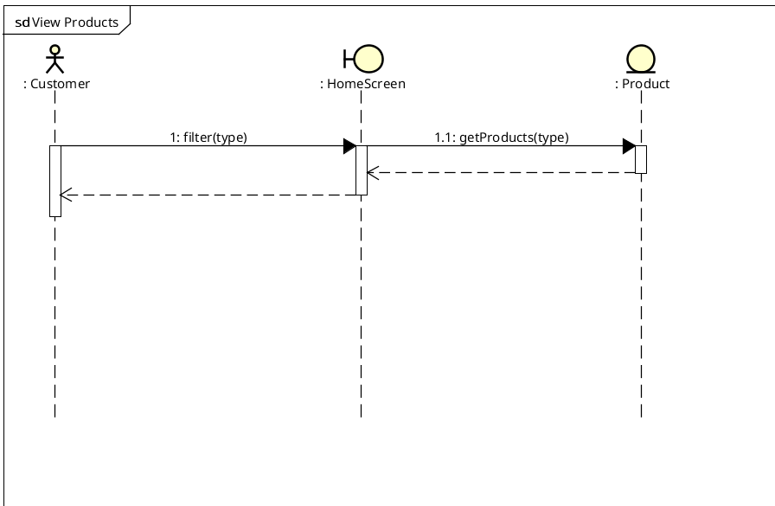
View Products UC

Slide 4
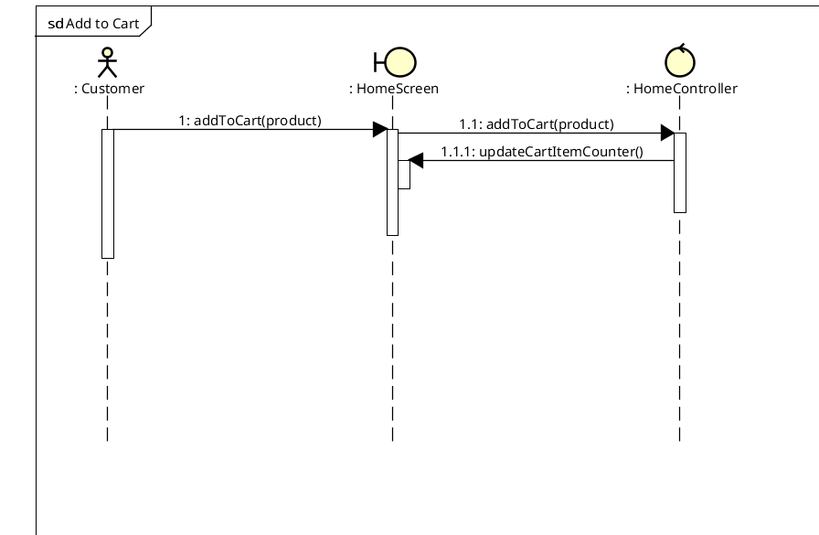
Add To Cart

Slide 5
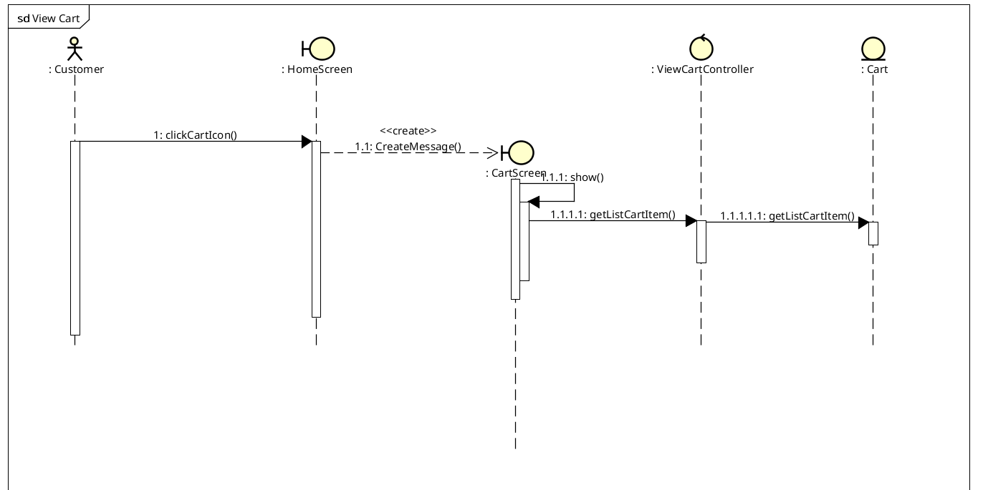
View Cart

Slide 6
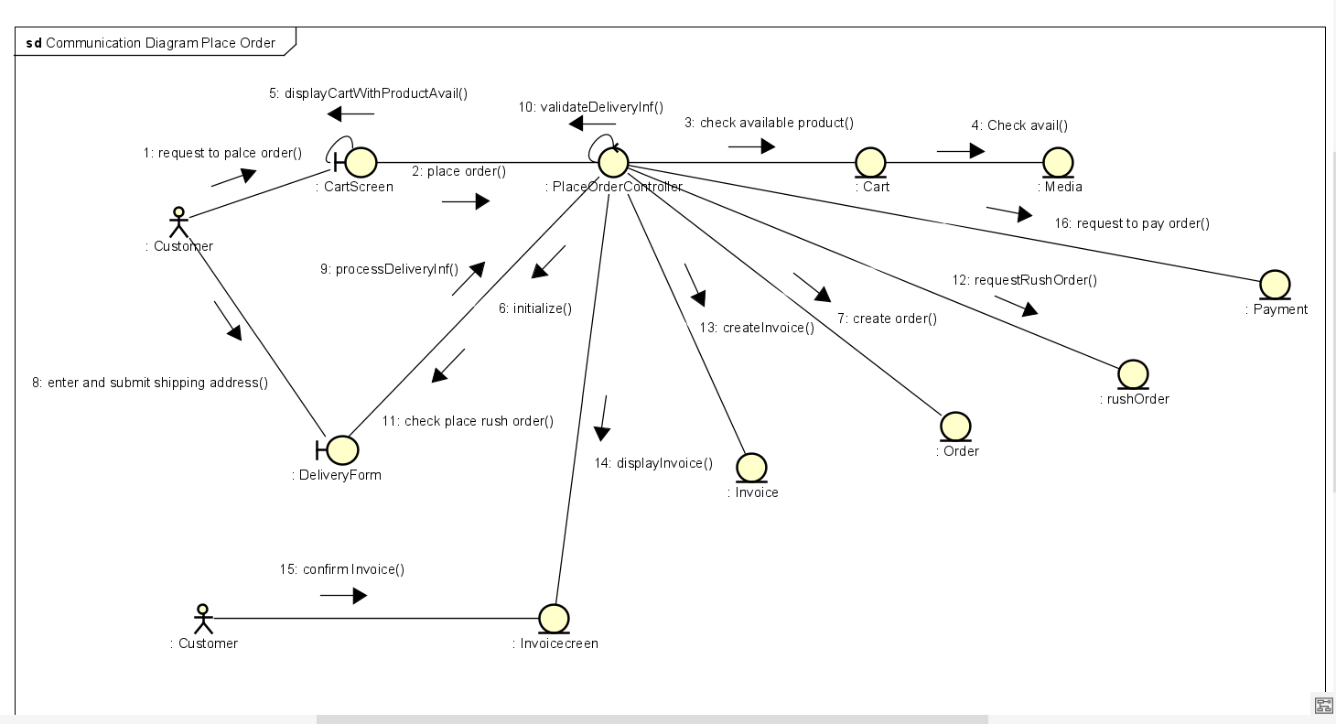
Place order

Slide 7
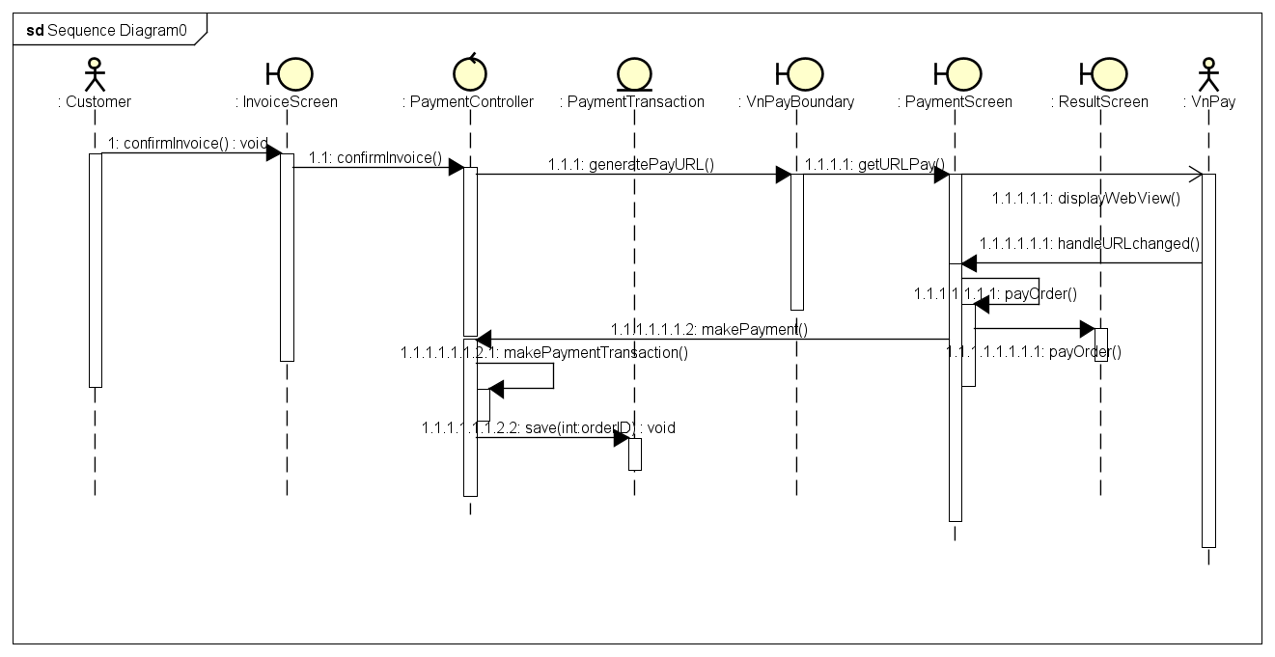
Pay Order

